Slide 1
Bike Sharing Demand
Forecasting bike rental demand for the city of Washington D.C.
By : Enrique Castillo, Erika Estrada, Walter Carbajal, Vrezh Khalatyan

Slide 2


What are bike sharing systems?
A sharing system for renting bicycles by means of membership or rental. Bicycles can be picked up at multiple locations and dropped off at multiple locations.

Slide 3

Why is such system so attractive for ML?
The data generated by these systems makes them attractive for machine learning because the duration of travel, departure location, arrival location, and time elapsed is explicitly recorded. Bike sharing systems therefore function as a sensor network, which can be used for studying mobility in a city.
B₈₉
B₃
B₂₃
K₁₀
B₁₁
B₇₅

Slide 4
The Goal
To combine historical usage patterns with weather data in order to forecast bike rental demand in the Capital Bikeshare program in Washington, D.C.
Input(data set) = Output(number of bikes)

Slide 5
DATA
Characteristics and Examination

Slide 6
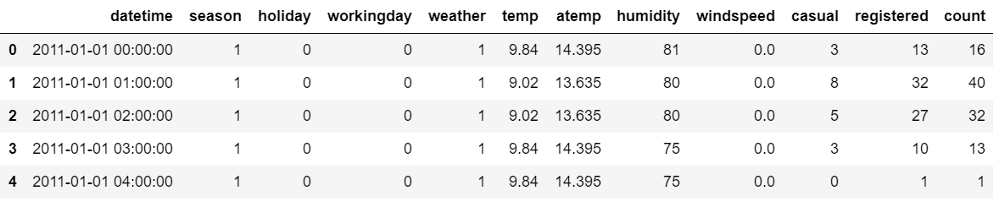
Original Data Set
Features
Target

Slide 7
Features Characteristics
Feature | Characteristic
datetime | hourly date + timestamp
season | 1 = spring, 2 = summer, 3 = fall, 4 = winter
holiday | whether the day is considered a holiday
workingday | whether the day is neither a weekend nor holiday
weather | 1: Clear, Few clouds, Partly cloudy, Partly cloudy 2: Mist + Cloudy, Mist + Broken clouds, Mist + Few clouds, Mist 3: Light Snow, Light Rain + Thunderstorm + Scattered clouds, Light Rain + Scattered clouds 4: Heavy Rain + Ice Pallets + Thunderstorm + Mist, Snow + Fog

Slide 8
Features Characteristics Continued
Feature | Characteristic
temp | temperature in Celsius
atemp | "feels like" temperature in Celsius
humidity | relative humidity
windspeed | wind speed
casual | number of non-registered user rentals initiated
registered | number of registered user rentals initiated
count | number of total rentals

Slide 9
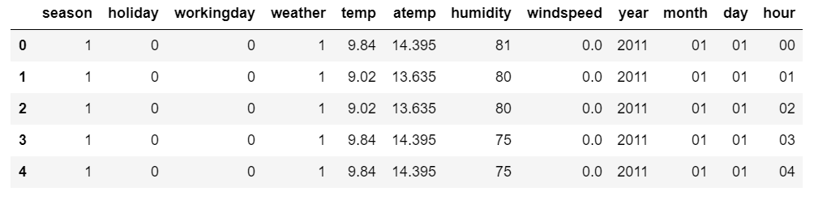
Features After Manipulation
casual and registered removed
datetime broken up

Slide 10
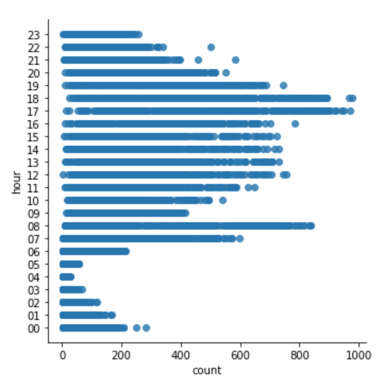
Pre-Examination of Data
Most bicycles used at 5PM
Least bicycles used at 4AM

Slide 11
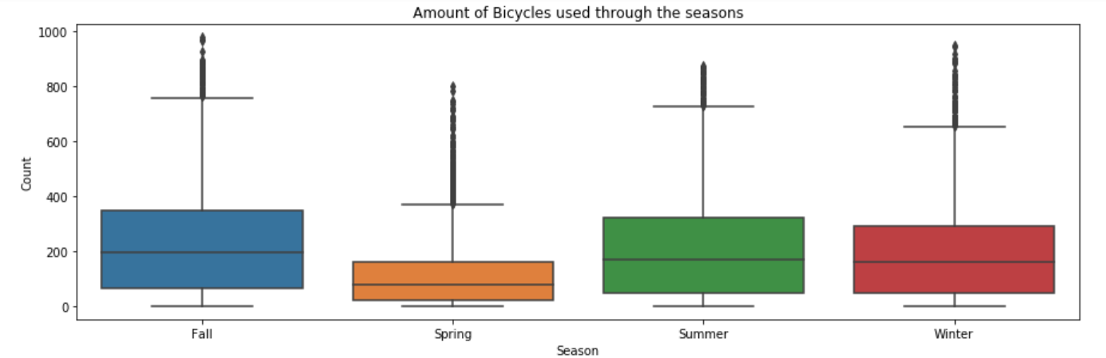
Pre-Examination of Data
largest value in the set
outliers
mean
smallest value in the set
common number of bicycles used throughout the season

Slide 12
ML Algorithms
Linear Regression
K-Neighbors Regressor
Decision Tree Classifier
Decision Tree Regressor
Random Forest Classifier
Random Forest Regressor
AdaBoost
REF (Recursive Feature Selection)

Slide 13
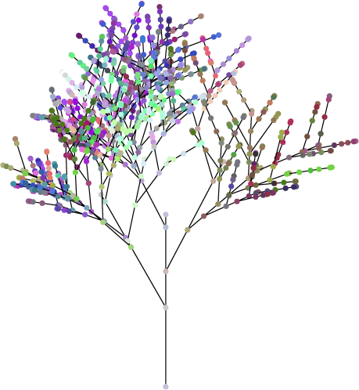
Decision Tree Classifier
This classic algorithm is the first stop when analyzing data, although it is not best suited for all types of data as we should soon find out.
Accuracy Score = 2.2%
Cross validation = 2.0%
R2 Score = 0.66

Slide 14
Random Forest Classifier
Another heavy hitter in the world of ML algorithms, this algorithm has the advantage of being good for both classification and regression problems. However, we let the results speak for themselves.
Accuracy Score = 1.9%
Cross Validation Score = 2.0%
R2 Score = 0.60

Slide 15
Analyzing Classifiers
After using the previous two classifiers with our dataset, we noticed that the following had little to no improvement or worsened our accuracies:
using 10-Fold Cross Validation
normalizing the dataset
increasing/decreasing random_state
increasing/decreasing n_estimators
Because of this, we can conclude that classifiers are not optimized for our particular dataset. Therefore, we will now try using regressors.

Slide 16
K-Neighbors Regressor
This ML algorithm uses feature similarity to predict values of any new data points. KNN in general, it's best used for classification problems but can also be used for regression problems.
Cross Validation score = 27.4%
R^2 score = 0.51

Slide 17
Decision Tree Regressor
Modified version of decision tree classifier, best suited for problems where the target consists of continuous values.
Cross Validation Score = 67%
R2 Score = 0.89

Slide 18
Random Forest Regressor
Random forest regressor gives better performance than its counterpart classifier. This is due to our target having continuous values.
Cross Validation Score = 77.52%
R2 Score = 0.9
Not bad! But, can we improve?

Slide 19
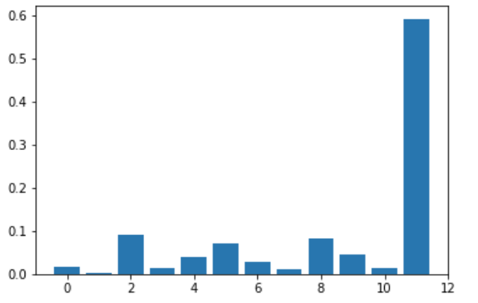
Feature Selection - Top 6
Rank | Feature | Score
1 | hour | 0.591
2 | workingday | 0.091
3 | year | 0.083
4 | atemp | 0.071
5 | month | 0.040
6 | temp | 0.038
Note: Score ranges from 0 to 1.

Slide 20

Random Forest Regressor
Survival of the Fittest
Random Forest Regressor with only the 6 best features
Cross Validation Score = 76.7%
R2 Score = 0.9
Training time
Accuracy
While scores slightly suffered complexity
diminished proportional.

Slide 21
Linear Regression
A basic but popular model to find the relationship between a dependent variable and a number of independent variables.
Cross Validation score = 13.8%
R^2 score = 0.41

Slide 22
Linear Regression
Adding dummy variables for the categorical data improves the accuracy of this model. Here, we are using 57 features. However, more features can lead to overfitting, so we must take these scores with caution.
Cross Validation score = 37.7%
R^2 score = 0.70

Slide 23
AdaBoost Regressor
Boosting algorithms turn several weak learners into a single strong one. Each model dictates which features will be used by the next model. It sounds promising, but our score is much lower than expected.
Cross Validation score = 4.3%
R^2 score = 0.62

Slide 24
AdaBoost Regressor
Again, adding dummy variables made a difference, and even more after reducing the large number of features according to RFECV. This is the accuracy with 36 features.
Cross Validation score = 9.1%
R^2 score = 0.63

Slide 25
Bagging Regressor
Bagging is an ensemble technique just like boosting, but it is simpler because all learners are combined without giving preference to any of them. Sometimes simple is better, as is the case here.
Cross Validation score = 78.8%
R^2 score = 0.94

Slide 26
Conclusion

Slide 27
Regressors VS Others
Algorithm | Cross Validation | R_2
Decision Tree Classifier | 2.0% | 0.66
Random Forest Classifier | 2.0% | 0.60
Kneighbors Regressor | 27.4% | 0.50
Decision Tree Regressor | 67.9% | 0.87
Random Forest Regressor | 79.7% | 0.94
Random Forest Regressor (Feature Selection) | 76.8% | 0.94
Linear Regression | 13.8% | 0.41
Adaboost Regressor | 42.6% | 0.62
Adaboos Regressor (Onehot encoding and feature selection) | 9.1% | 0.63
Bagging Regressor | 78.8% | 0.94

Slide 28
Most Optimal
We’ve tried many algorithms and several techniques to improve our outcome.
By far regressors were the winners in this race, and while feature selection did help our computing time it also slightly brought down our accuracy.
Onehot encoding did very little to improve our outcome.
Thank You!

